Slide 1
SQL Triggers
David, Michael, Jacob, Jack, Angeleen
I knew predefined triggers weren’t a thing
(try not to get triggered)

Slide 2
What is a Trigger
A Trigger is a set of actions that the database performs once the requirements are met
An example being a when a customers data has been added to the company's database rather then sending them a welcome email manually, the company can set up a trigger to have the database automatically send them a welcome email.

Slide 3
Types of SQL Triggers
DDL (Data Definition Language) - This class of triggers fires upon events that change the structure (like creating or dropping a table)
DML (Data Modification Language) - This is the most used class of triggers. In this case the firing event is a data modification statement; it could be an insert, update or delete statement either on a table or a view.
Logon - is fired when a LOGON event occurs i.e. when a user session is being established

Slide 4
DDL Events
Triggered by create, alter, and drop statements
Used to:
Prevent changes to database schema
Record changes in database schema
Respond to changes in database schema
Types of DDL Triggers:
Transact-SQL DDL Trigger
CLR DDL Trigger

Slide 5
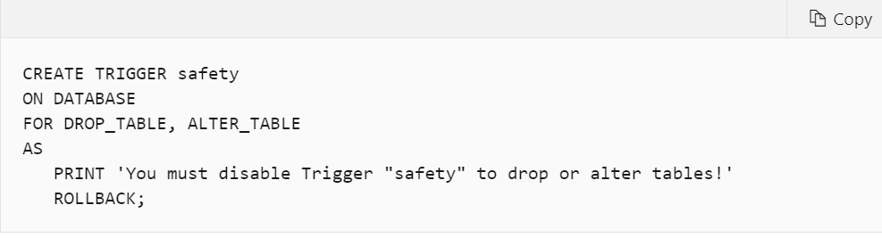
Transact-SQL DDL Trigger
A special type of Transact-SQL stored procedure that executes one or more Transact-SQL statements in response to a server-scoped or database-scoped event
For example, a DDL Trigger may fire if a statement such as Drop Table is performed

Slide 6
CLR DDL Trigger
A CLR trigger executes one or more methods written in managed code that are members of an assembly created in the .NET Framework and uploaded to SQL Server
Allows for triggers to be coded in one of the .NET compliant languages like C#, VB.Basic, and F#
Creating a CLR trigger in SQL Server involves the following steps:
Define the trigger as a class in a .NET Framework-supported language
Compile the class to build an assembly in the .NET Framework using the appropriate language compiler
Register the assembly in SQL Server using the CREATE ASSEMBLY statement
Create the trigger that references the registered assembly

Slide 7
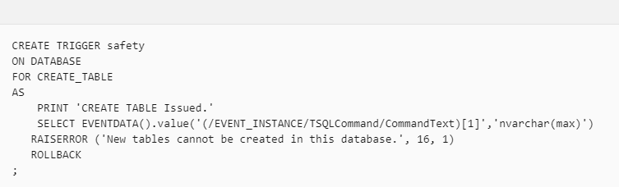
EVENTDATA Function
Information about an event that fires a DDL trigger is captured by using the EVENTDATA function
Returns an xml value
Includes information about:
The time of the event
The system process ID (SPID) of the connection when the trigger executed
The type of event that fired the trigger
May include other information depending on the event type

Slide 8
DML Events Triggers
The CREATE TRIGGER statement allows you to create a new trigger that is fired automatically whenever an event such as INSERT, DELETE, or UPDATE occurs against a table.
The Trigger can be configured to execute either before the event specified or after using the commands BEFORE or AFTER as well as a INSTEAD OF (yes i know very complex syntax)

Slide 9
Before, After, Instead Of
Before:
triggers run the trigger action before the triggering statement is ran. This type of trigger is commonly used in the following situations
When the trigger action determines whether the triggering statement should be allowed to complete. Using a BEFORE trigger for this purpose, you can eliminate unnecessary processing of the triggering statement and its eventual rollback in cases where an exception is raised in the trigger action.
To derive specific column values before completing a triggering INSERT or UPDATE statement.
After(For):
triggers run the trigger action after the triggering statement is ran.
triggers are never executed if a constraint violation occurs
Instead Of:
is a trigger that allows you to skip an INSERT, DELETE, or UPDATE statement to a table or a view and execute other statements defined in the trigger instead. The actual insert, delete, or update operation does not occur at all.
You can't specify INSTEAD OF for DDL or logon triggers

Slide 10
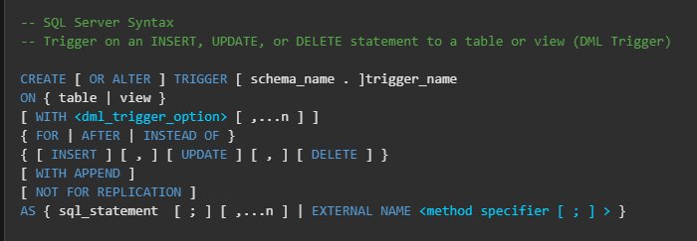
DML Trigger Format
Notes:
Hand off to David

Slide 11
Logon Events
Logon Events are used to control SQL login security
The event is triggered when a user’s name and password is authenticated before a new session is established
Frequently used to:
Log the name and time of user login activity
Limit the number of simultaneous user sessions
Limit the number of connections allowed for a user

Slide 12
Advantages and Disadvantages of using SQL Triggers
Advantages
It is used for checking the integrity of the data.
Triggers can be used for catching errors in any field.
SQL triggers are a better alternative for running scheduled tasks, i.e. by using SQL triggers we don’t have to wait for running the tasks planned because the triggers get automatically invoked whenever there is any change in the table.
SQL triggers are also used for official inspection of data in the tables.
Disadvantages
SQL triggers are used for providing an extended validation, and they cannot be used for replacing all the validation which can be done only by the application layer.
SQL triggers are executed from the client applications, which will be challenging to figure out what is happening in the database layer.
It increases the overhead of the database server.

Slide 13
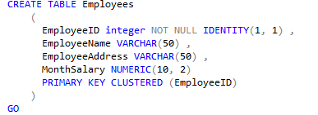
DEMO
Notes:
Angeleen

Slide 14
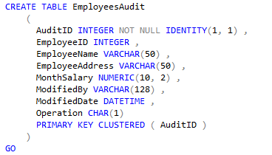
DEMO
Notes:
Angeleen

Slide 15
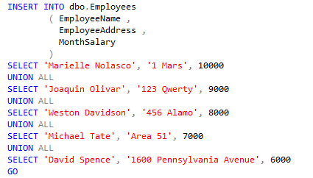
DEMO
Notes:
Angeleen

Slide 16
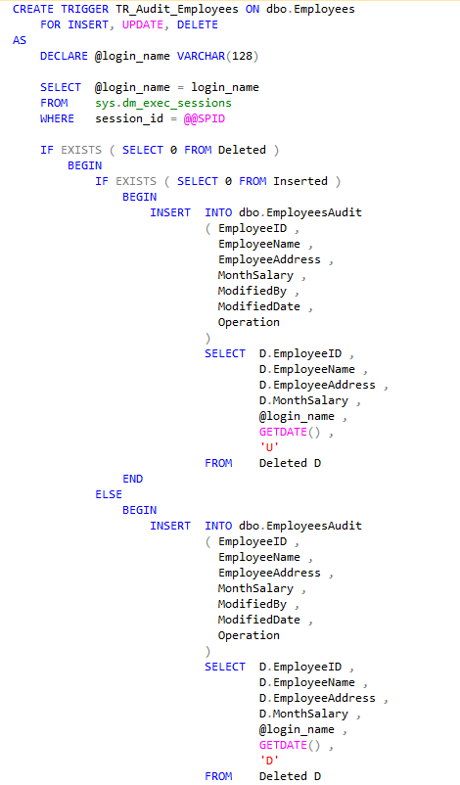
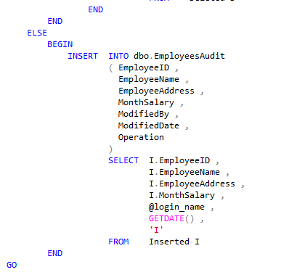
DEMO
Notes:
Angeleen

